Slide 1
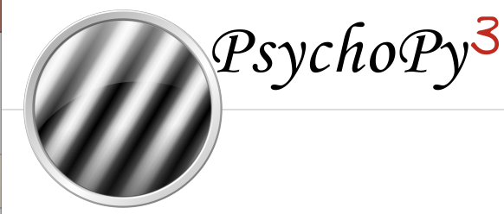
How to Psychopy
Basic introduction to Python and Pyschopy
Kevin da Silva Castanheira

Slide 2
Why Psychopy?
Flexible
Compatible with different systems (mac, windows)
They have a GUI for building experiments
Free to use
Great for reproducible science!
Find the documentation here

Slide 3
Outline
Getting Set-up
Anaconda Environments
Downloading python packages
Python Basics
Importing packages
Variable types
For loops & While Loops
Functions
Conditionals
Global vs Local Variables
Running a python scripts
Presenting stimuli in Psychopy
Recording responses
Saving the data
Instructions
Example Task

Slide 4
Anaconda
To create a virtual environment use the following command. Here I named the environment “Psychopy”, but you can name it whatever you like
conda create -n Psychopy python=2.7
To activate an environment use the source activate command with the name of the environment
Source activate Psychopy (for Mac)
Conda activate Psychopy (for PC)
To deactivate an environment use the source deactivate command
Source deactivate (for MAC)
Conda deactivate (for PC)

Slide 5
Installing packages
You can use the conda command when in a virtual enviornment to install a package
conda install -c cogsci psychopy
Or you can use the pip command to install a package
Pip install package name
Pip install pygame
Pip install pandas

Slide 6
Python: Importing packages
At the start of your code you can use import statements to import functions from (already installed) libraries you may need
Three kinds of imports
Import random
Need to use the name of the library when calling functions (e.g. random.sample())
Import pandas as pd
Need to use the name you gave the library when calling functions (e.g. pd.read_csv())
From psychopy import event
Only imports the functions in that are contained in that module
Need to use the name of the module when calling functions (e.g. event.waitKeys())

Slide 7
Python: Variable Types
Python has a few variable types:
Numbers
Integers (whole numbers) vs float (decimals)
Strings
[Lists]
mutable
(Tuples)
immutable
{Dictionaries}
Can index entries by position OR key name
Read more about variable types in python here

Slide 8
Python: For Loops & While loops
For loops and while loops let you do something repeatedly until you meet some condition
For loops are generally used when you know when to stop
i.e. iterate through this list
While loops are generally used when you are uncertain when to stop
i.e. run this segment of code until your variable reaches a certain value

Slide 9
Python: Functions
Used to perform a specific task given some input
You can used pre-defined functions from libraries or you an define your own
To call a function simply write the name and pass the input arguments
myFunction(input1, input2, input3)
To define a function:
def myFunction(input1, input2, input3=Default):

Slide 10
Python: Conditionals
Use conditional statements to control the flow of your code
If statements will only execute the code within them if you satisfy a condition
Else will execute the code only if the matching if statement wasn’t satisfied
Elif will execute the code if you didn’t satisfy the matching If AND you satisfy the matching conditional statement
if Color=="blue":
print(“blue”)
elif Color=="red":
print(“red”)
Else:
print(“other”)

Slide 11
Python: Global vs Local Variables
Variables can either be Global or Local
Global variables can be accessed by any function in your code
Local variables can only be accessed within the function they were defined

Slide 12
Python: Running the Script
To run a python script in the terminal simply enter python and the path to the script
If you’re on Mac
Python ./desktop/Psychopy/TaskSwitching/Run.py
If you’re on PC
Python C:\\Users\Kevin\Desktop\Psychopy\TaskSwitching\Run.py

Slide 13
Psychopy: Window
win = win = visual.Window((1280, 800), fullscr=True, color=(-1,-1,-1), winType="pygame")
win.mouseVisible = False
Notes:
https://www.psychopy.org/api/visual/window.html

Slide 14
Psychopy: Timing
You can use the psychopy function core.wait() to pause your code for a given amount of time (seconds)
This function takes in the number of seconds you want to wait before executing the next section of code
This is important for control the timing of the trials and for contorling how long the stimulus is on the screen
Example: core.wait(2.5) to wait for 2500 ms

Slide 15
Psychopy: Stimuli
Psychopy has several built in functions to present visual, text and audio stimuli
For visual stimuli (images and text) you need to define the stimulus first before drawing it to the buffer
After drawing the stimulus to the buffer, you can “flip” the window which displays everything in the buffer to the window
Win.flip() also clear the buffer
Sandwiching stimulus drawing between win.flip()s helps avoid drawing stimuli on top of each other
Make sure to add core.wait() statement after drawing your stimulus to ensure it is on the screen for the desired amount of time

Slide 16
Psychopy: Text Stimuli
You can present text stimuli with the TextStim function where you can specify the window, text, color and height.
Color is usually mapped in psychopy’s color space (like rbg)
Three numbers represent colors Red, Green, Blue (in that order)
They vary from -1 to 1 where (-1,-1,-1) is black, (0,0,0) is grey and (1,1,1) is white
Red (1,0,0); Green (0,1,0); blue (0,0,1)
Height and pos are in the units of the window (usually a decimal)
Pos (x, y) where negative values are left (or below) and positive are to the right (or above)
visual.TextStim(win=win, text=text,color=color, height=height)

Slide 17
Psychopy: Image Stimuli
You can present image Stimuli with the ImageStim function
Supply the function with a window and a path to the image file you want to draw
Similar with text you can control where the image is drawn with the pos parameter
You can also control the size of an image with the size parameter
visual.ImageStim(win=win, image=path, pos=pos, size=size)

Slide 18
Psychopy: Audio Stimuli
You can also add sounds to your psychopy task by using the psychopy function sound
Like the image function, this function takes the path to your sound file to be played
To play a sound you need to first define your sound before playing it (much like drawing for visual stimuli)
SoundStim = sound.Sound(path)
SoundStim.play()
This function seems to have some compatibility issues with PCs
If you figure out how to use it reliably on a PC let me know

Slide 19
Note on Stimuli Generation
In order to facilitate stimulus presentation and ensure everyone sees the same set of stimuli (maybe in a different order), you can read in the stimuli from a file (like a csv)
You can shuffle the data frame of stimuli by using the sample function
i.e. for a data frame named df:
df.sample(frac=1)
Alternatively you can read in pre-determined Run Orders saved in separate csv files
This allows you to have maximal control over what people see instead of randomly generating the stimulus order/set

Slide 20
Psychopy: Button Presses
Getting button presses in Psychopy is made easy with the waitKeys function
This function takes in the list of keys you are interested in and the maximal wait time (seconds) you are willing to wait for a response
Code following this line will not be executed until either a key is pressed or the maximal wait time is met
buttons = event.waitKeys(maxWait=5, keyList=["left", "right", "escape"])
Notes:
https://www.psychopy.org/api/event.html

Slide 21
Psychopy: Response Times
Getting response times are simplified with the psychopy fucntion monotonicClock
Start the clock when you want to start the timing (like a stop watch) and then use the getTime function to findout how long has it been since the clock was started
Example:
stimulusOnset = core.MonotonicClock()
stimulusOnset.getTime()

Slide 22
Saving the data
An easy way of saving the data from your task is to store each variable of interest in a list and then turn this list into a pandas DataFrame in order to write it to a csv
I like to make a list of global list variables and append to them as the task progresses
When you want to save the data to a file, first turn that set of lists into a dictionary with column names before converting the dictionary to a dataFrame
output_data = {'PID':Data_PID,'RT':Data_RT, ”Response”:Data_Response}
output_data = pd.DataFrame(output_data)
output_data.to_csv(outputDirectory+"/"+PID+"_data.csv", mode="a", index=False, na_rep="NA", header=True)
Make sure the lists are of equal length

Slide 23
Counterbalancing
You can add your own counterbalance variables in python and use if statements to control what people see
For example response mapping or condition mapping
An easy way to do this is to randomly sample an integer number and assigning that as a counterbalance for your participants
For example if you have 4 counterbalances you could do
Counterbalance = random.sample([0, 1, 2, 3], 1)[0]
Alternatively you can have receive this as input from the terminal like you would for participant ID
Counterbalance = input(”Counterbalance (e.g. 0 or 1):\n")

Slide 24
Instructions
In order to facilitate showing instructions, I use power-point slides which I export as image files and display them one at a time
You can draw the images using the psychopy ImageStim function and a for loop to iterate through the files
You can use the waitKeys function to get a response to indicate you want to move onto the next slide
Let’s look at a simple example of what this would look like

Slide 25
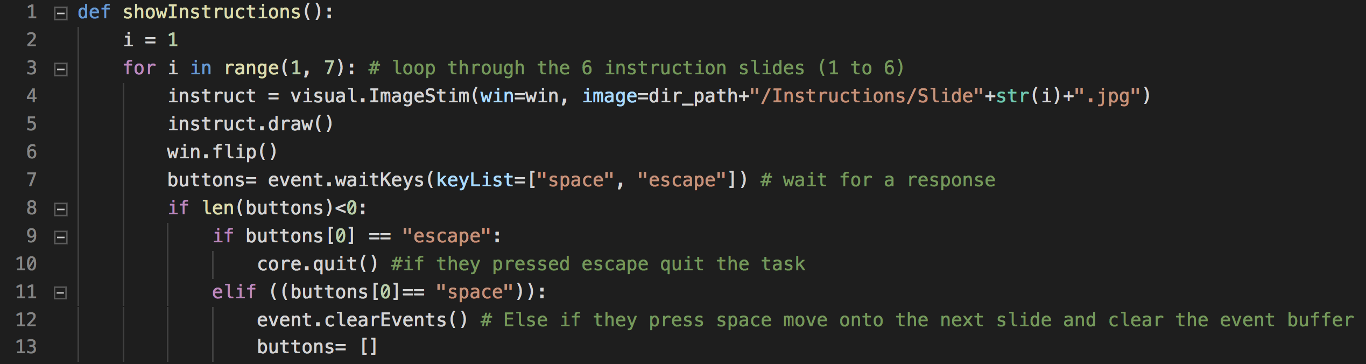
Instruction Example
Where win (psychopy window) and dirpath (directory path of where the code is) are global variables defined elsewhere
>

Slide 26
Example Task: Task Switching
In order to better understand how all these functions can be combined to make a working psychology task I coded a simple experiment that uses all the discussed features of psychopy
The experiment is a task switching experiment in which people have to respond if a number is odd or even (parity) or if a number is larger than 5 (magnitude)
The task is indicated by color of the Number
Before each trial you are shown how much money you can make for a correct response

Slide 27
Structure of Function Calls
Main
Show_instructions
Show_me_2lines
Show_me
Practice
Run_Task
Set_OutputDir
QuitSequence
Show_me
Show_me
QuitSequence
QuitSequence

